Slide 1
COVID-19 Vaccine Data
How do other countries compare to the US when it comes to COVID-19 vaccine distribution?

Slide 2
The Data Source
The data that will be used for this project is a csv file that provides information on COVID-19 vaccine distribution for multiple countries (over 10,700 entries). There are multiple variables that will be considered for this project to help answer the research question:
Country
Date
Total vaccinations – a percentage per hundred by population
Total people vaccinated – a percentage per hundred by population
Total people fully vaccinated – a percentage per hundred by population
Daily vaccinations – a percentage per million by population
https://www.kaggle.com/gpreda/covid-world-vaccination-progress?select=country_vaccinations.csv

Slide 3
Relationship Between Variables
The relationships between variables include the following:
Total people vaccinated vs total people fully vaccinated- the total includes the number of those fully vaccinated.
Total vaccinations include all the number of vaccination that have been given, therefore is a combination of total people vaccinated and those fully vaccinated.
Daily vaccinations are a sub-category of the above variables due to it only being a daily statistic.
I will also be comparing these variables by country so different countries will be analyzed based off the vaccination variables.

Slide 4
Data Cleaning Techniques
Handling missing values: There were a handful of countries that had missing data, those were discarded. Similarly, most 2020 dates for countries were missing data as well due to the vaccine not being available at that time yet.
Combining entries for single country: I will use groupby() to group information by country.
Sorting information: I removed any unused columns such as the source of the vaccine, country code, stats that weren’t by population, and the website.

Slide 5
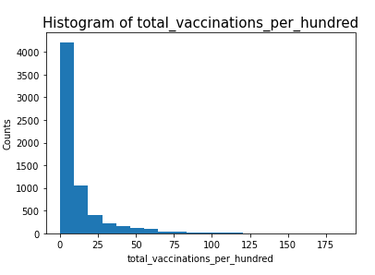
Histograms of each variable Total Vaccinations Per Hundred

Slide 6
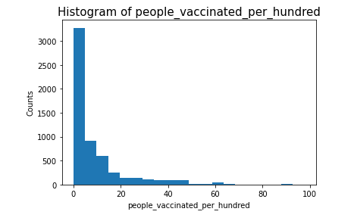
Histograms of each variable Total people Vaccinated Per Hundred

Slide 7
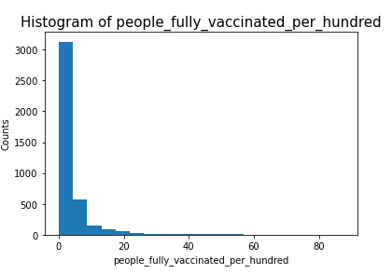
Histograms of each variable Total people Fully Vaccinated Per Hundred

Slide 8
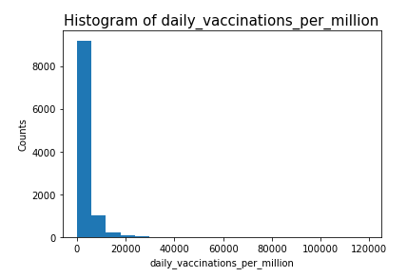
Histograms of each variable Daily Vaccinations per million

Slide 9
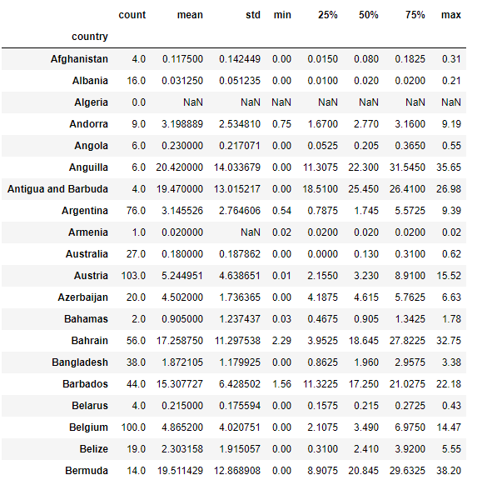
Summary Statistics
The following are the summary statistics of total vaccine per hundred by country. Note that not all countries are displayed due to too many rows. Only the first 20 entries shown here.

Slide 10
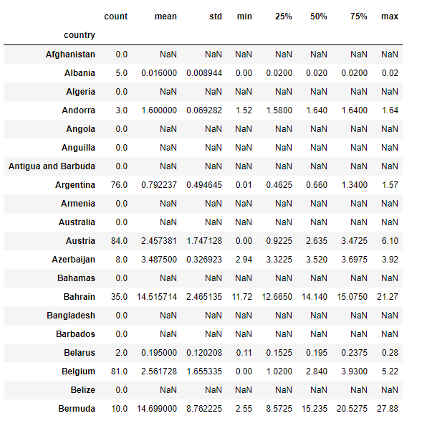
Summary Statistics
The following are the summary statistics of people fully vaccinated per hundred by country. Note that not all countries are displayed due to too many rows. Only the first 20 entries shown here.

Slide 11
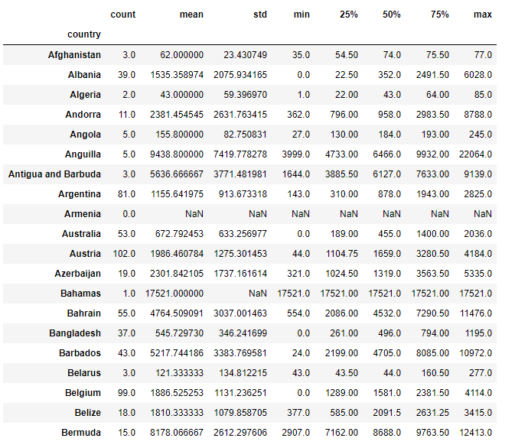
Summary Statistics
The following are the summary statistics of daily vaccinations per million by country. Note that not all countries are displayed due to too many rows. Only the first 20 entries shown here.

Slide 12
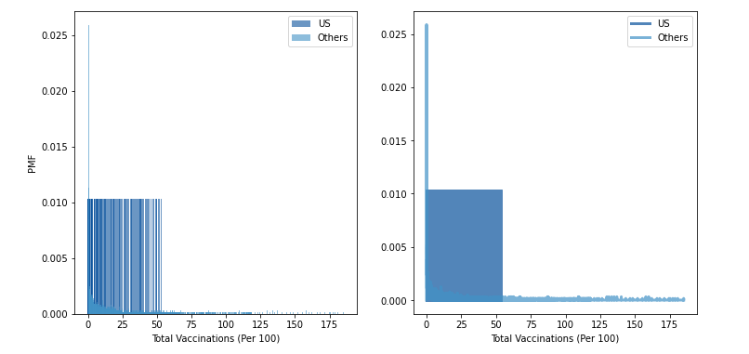
Comparing US vs other Countries using PMF
I pulled out the US data and non-US data from the total vaccinations per hundred variable and compared histograms and PMFs for each scenario. We can see that the US is steady at 0.01 whereas other countries are more skewed to the left.

Slide 13
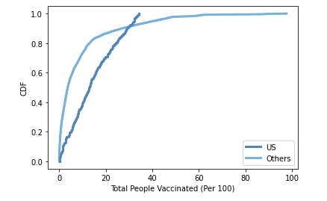
CDF of Total People Vaccinated
I created a CDF of total people vaccinated for US and non-US data and compared the two. We can see that although they both have an exponential distribution, the US distribution is much steeper with a rapid increase in the number of people vaccinated.

Slide 14
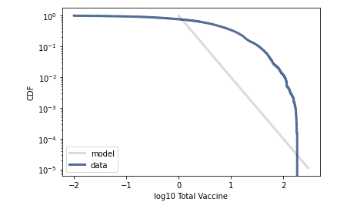
Pareto Distribution
Since the data was clearly not normal from the histograms, I decided to start with a Pareto distribution. As you can see from below this is not a good representation of the data.

Slide 15
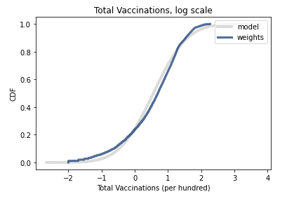
Lognormal Distribution
I then moved on to see if a lognormal distribution was a good model for the data. As you can see this is a much better fit.

Slide 16
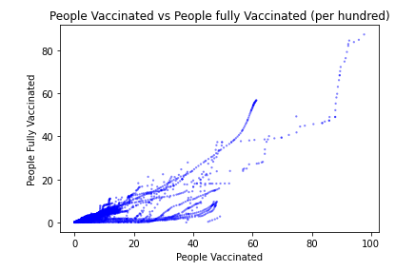
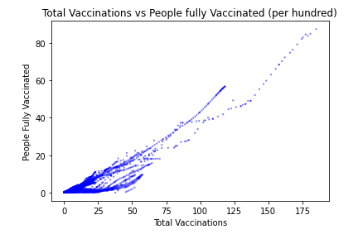
Scatter Plots
Both scatterplots are very similar, with high concentrations around zero. They also both tend to have a slight linear shape as they have a positive incline toward the top right-hand side of the graph.
People Vaccinated vs People fully Vaccinated (per hundred)
Total Vaccinations vs People fully Vaccinated (per hundred)

Slide 17
Correlation and Causation
People Vaccinated vs People fully Vaccinated (per hundred)
Total Vaccinations vs People fully Vaccinated (per hundred)
Pearson’s Correlation:
0.8202384565786762
Spearman’s Correlation:
0.8061366462984914
These variables are highly positively correlated, and since the values between Pearson and Spearman’s are similar it suggests that the skewness in the distribution explains most of the difference between the two values.
Pearson’s Correlation:
0.9283372567033286
Spearman’s Correlation:
0.8581775536792849
These values are also highly positively correlated, more so than the values on the left, however the difference in Pearson and Spearman’s correlation is slightly greater. Since Spearman’s correlation is more robust and accurate with non-linear data, it’s safe to assume the value is closer to 0.86.

Slide 18
Testing a difference of Means
For my hypothesis testing, I decided to try testing the difference of means between the total vaccinations per hundred vs the people fully vaccinated per hundred since they were more highly correlated in the last slide.
Results gave a p-value of 0.0 which further shows that the two variables are statistically significant.

Slide 19
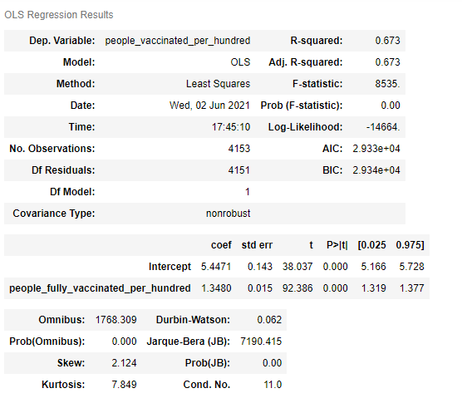
Regression Analysis
I decided to go further with these two variables to see how they could potentially predict where a country would be at for fully vaccinated individuals if you knew the countries total number of people vaccinated.
The results on the right show that the p-values are 0.0 as expected, and the coefficient of determination (R²) value is high (67%), so this shows that the two variables are statistically significant.

Slide 20
conclusion
Through my analysis I was able to conclude the following:
The number of zeros in the data could have skewed some of the information and made the distribution not normal. If more countries had vaccines available and more data was present, perhaps there would be different results.
A lognormal model is a good fit for the distribution of this data.
Total vaccinations and people fully vaccinated are positively correlated and statistically significant.
The US was slow to start, but has exponentially grown in vaccine distribution compared to other countries.

